Slide 1

Non-Current Liabilities Part 2 - Video

Slide 2
Today’s Video
Bond Retirement
Fair Value Option

Slide 3
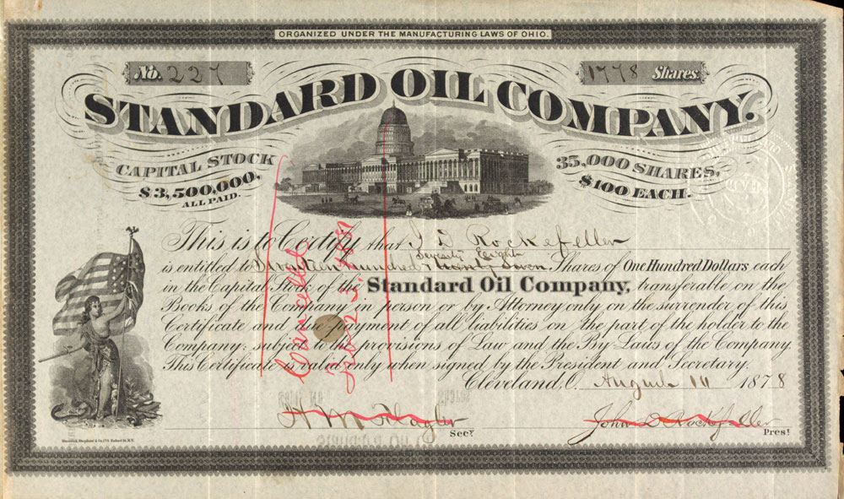
Bond Retirement
Bond retirement is when you repay the lender and extinguish the liability.
When to retire:
At maturity (the end of the debt term)
Early (whenever you want to)

Slide 4
Retirement at maturity
At the end of the debt term:
Carrying value is equal to face value (no premium or discount remains)
Derecognize the bond payable and record payment of cash
Bond Payable (B-L) XX
Cash (B-A) XX
*XX = Face Value

Slide 5
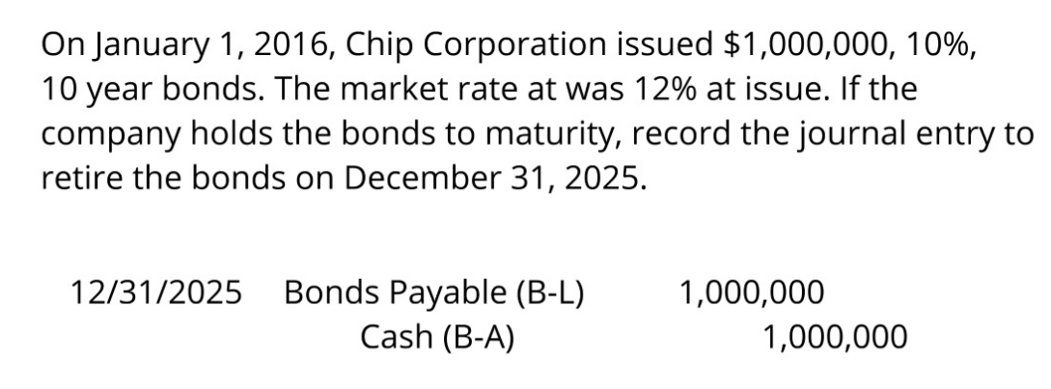
Example (at maturity)

Slide 6
Early Retirement
Early Repurchase or Redemption: Company retires bond before maturity date.
Determine amount of cash paid out (call provision, current market value/price, or PV at current market rates)
Compare cash paid out to current CV of bond; difference is gain or loss
Derecognize bond payable and any remaining discount/premium

Slide 7
Early Retirement (Simple)
Early Repurchase or Redemption: Company retires bond before maturity date.
Pay cash at current market value
Remove liability
Plug JE to gain/loss

Slide 8
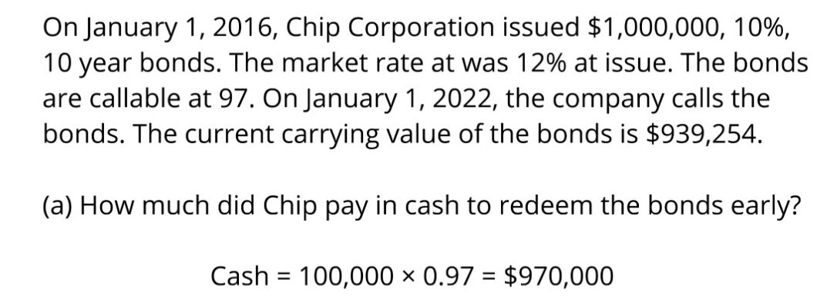
Example (early retirement)

Slide 9
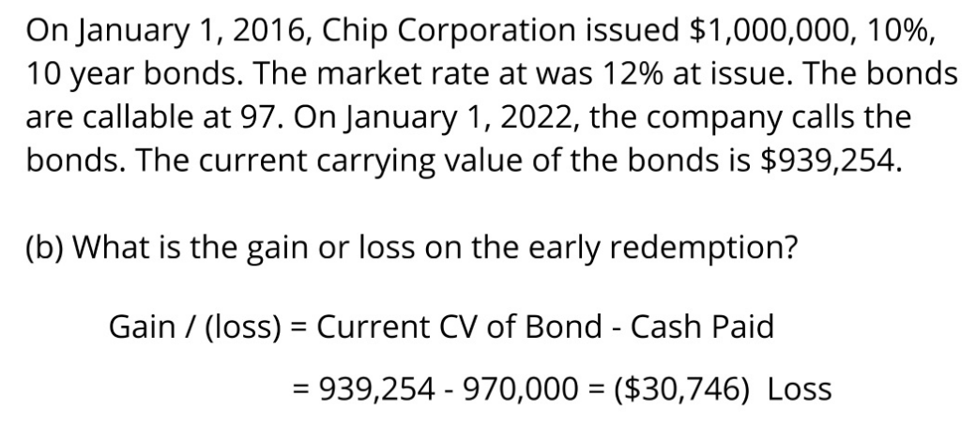
Example (early retirement)

Slide 10
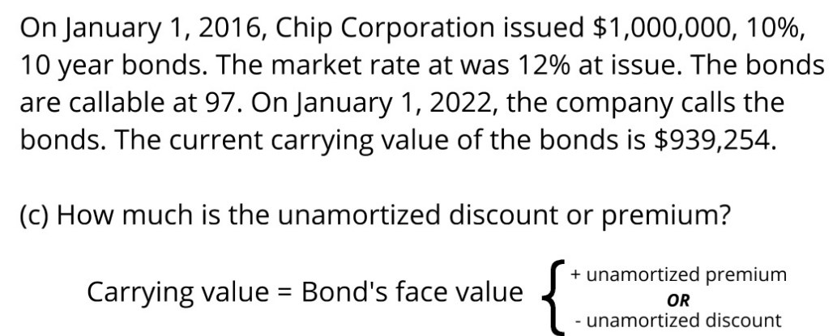
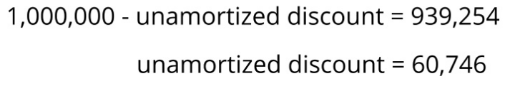
Example (early retirement)

Slide 11
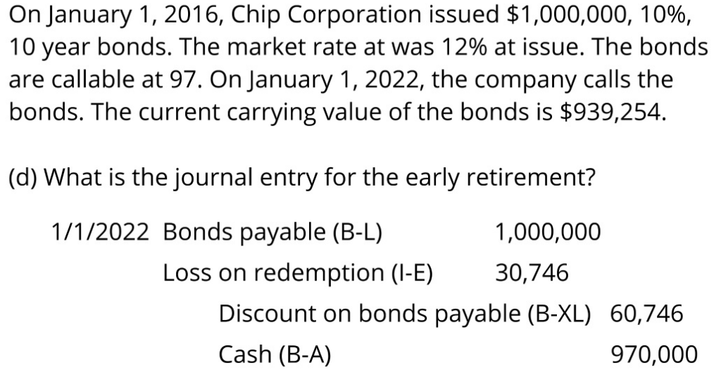
Example (early retirement)

Slide 12
Fair Value Option
Notes:
Talk about (1) and (2) from next slide here

Slide 13
Fair value option for bonds and notes
Companies may elect the fair value option at the time it issues debt.
Reporting choice is generally irrevocable (by instrument).
At issue → Report the liability on the balance sheet at fair value.
Over time → Adjust liability to FMV and report adjustments as unrealized gains and losses in net income.
Bond value ↑
Unrealized holding loss xx
Bond payable (fair value adjustment) xx
Bond value ↓
Bond payable (fair value adjustment) xx
Unrealized holding gain xx
Notes:
Fair value
Pros: relevant, reliable (?)
Cons: not always easily determined, income volatility
Market Rate increases, bond value falls, firm gets a gain (holders get a loss)
Market Rate decreases, bond value increases, firm gets a loss (holders get a gain)

Slide 14
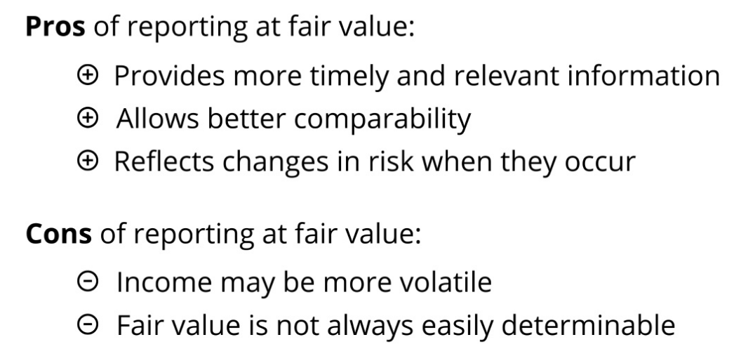
Fair value option

Slide 15
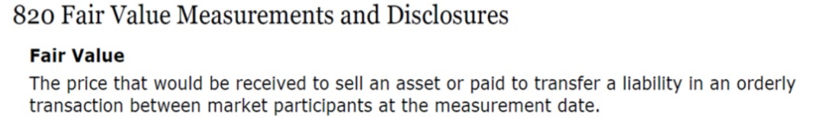



Measuring Fair Value

Slide 16
Fair value option for bonds and notes
Example: Suppose Triton Inc. issued 500,000 6% bonds at face value on January 1, 2016 and chose to report the bonds using the fair value option. At December 31, 2016, market rate has increased to 8%. As a result the value of the bonds falls to 480,000.
Initial Issue (1/1/2016)
Cash 500,000
Bond payable 500,000
Fair Value Adjustment (12/31/2016)
Bond payable 20,000
Unrealized holding gain (I-R) 20,000
Notes:
Fair value
Pros: relevant, reliable (?)
Cons: not always easily determined, income volatility

Slide 17
Closing Thoughts
When retiring bonds at end of debt term, remove bonds payable and pay cash at face value.
Early bond retirement may involve a gain or loss. Pay cash at current fair value, remove liability. Difference is gain/loss.
Firms can elect to report debt at fair value.

Slide 18
Non-Current Liabilities Part 2 - Video

